Slide 1
IoT Byte-Sized: IoT Device Management
WELCOME!
Allen R. Sanders
Senior Technology Instructor

Slide 2

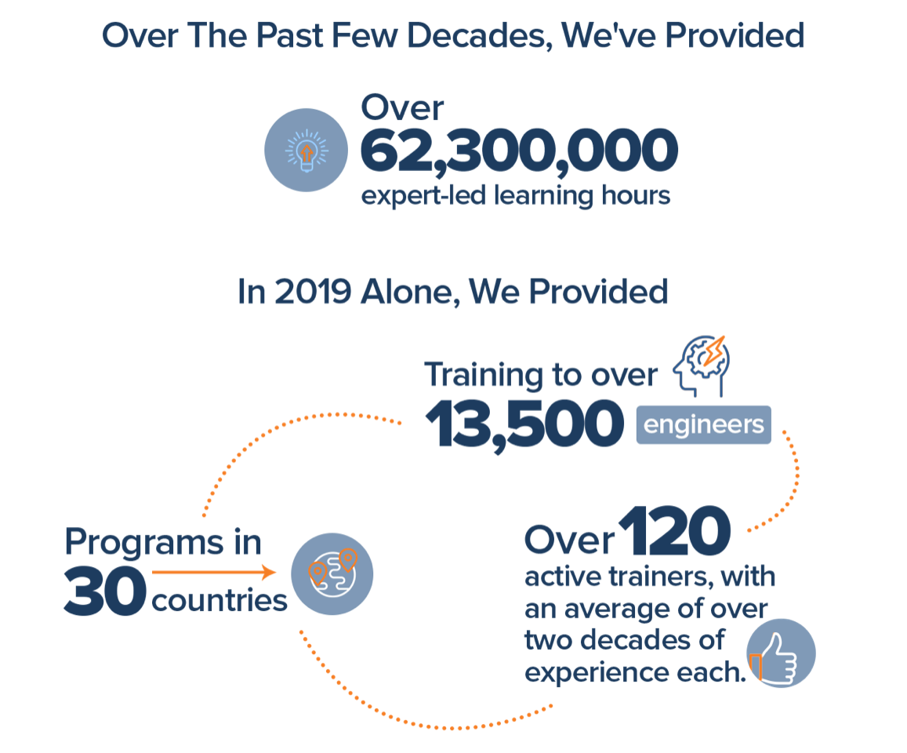
Join Us in Making Learning Technology Easier
Our mission…
Over 16 years ago, we embarked on a journey to improve the world by making learning technology easy and accessible to everyone.
…impacts everyone daily.
And it’s working. Today, we’re known for delivering customized tech learning programs that drive innovation and transform organizations. In fact, when you talk on the phone, watch a movie, connect with friends on social media, drive a car, fly on a plane, shop online, and order a latte with your mobile app, you are experiencing the impact of our solutions.
Copyright DevelopIntelligence LLC
Notes:
ACTION: Share a bit about DevelopIntelligence
- As developers you want to learn!
- As a corporation you want your developers to align their learning with your business goals.
- That’s where we come in… Keeping developers current, bringing others up-to-speed … all aimed at moving your business forward!
- DI was started in 2003 by a Sun Microsystems developer that wanted to help developers level-up and see business better leverage IT

Slide 3
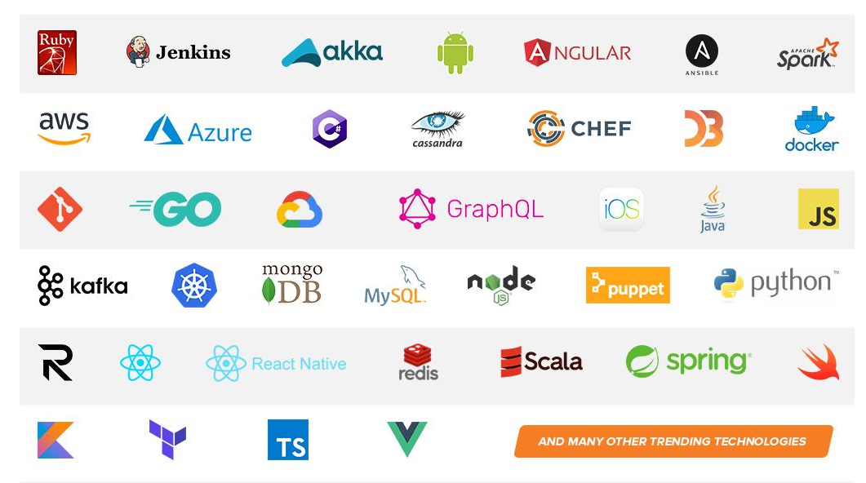
Technologies we cover
Notes:
ACTION: Share some of the technologies we teach
Areas of DevelopIntelligence expertise
DevOps: Ansible / Jenkins
BigData: Hadoop / Cassandra / Spark
Machine Learning
Front-end: React / Angular
Cloud: AWS / Azure / Google Cloud
- Started as a Java shop -> kept growing -> haven’t looked back
- Our specialty is hiring expert practitioners that can come alongside teams and teach them how to move forward

Slide 4
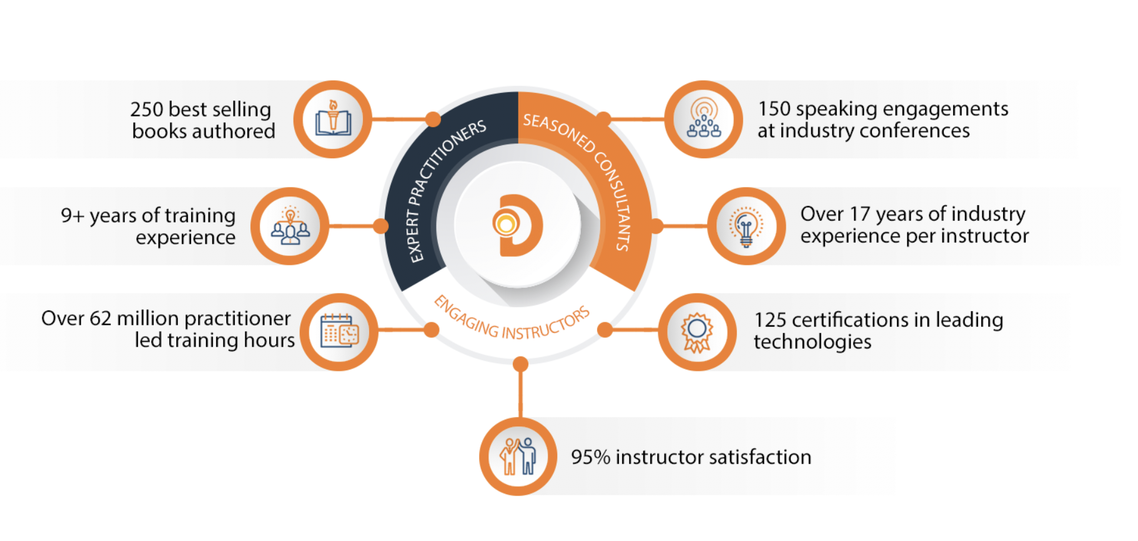
World Class Practitioners
Notes:
ACTION: Share about what makes the DevelopIntelligence instructor team one of-a-kind!
Here is some data showing instructors are expert practitioners, engaging instructors, seasoned consultants. We are the best in the business!

Slide 5



Virtual Training Expectations for You
Arrive on time / return on time Mute unless speaking Use chat or ask
questions verbally
Notes:
ACTION: Share the expectations you have for the students
Level set the rules of engagement for virtual classrooms. Encourage students to be on time! Just because this is a virtual class doesn’t mean it’s ok to inconvenience peers who showed up on time.
Mute yourself unless asking a question/commenting
Ask questions (verbally or via chat window)

Slide 6
Purpose
Gain a deeper understanding of IoT device management at scale

Slide 7
Objectives
Upon completion of this course, you should be able to:
Explain the key principles of IoT device management
Describe the IoT device lifecycle
Define device twins and shadows
List the patterns for device management in IoT

Slide 8
Introduction

Slide 9
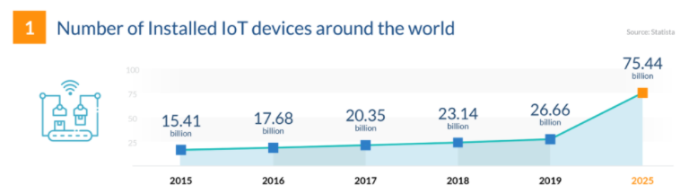
Industry Trends
From https://financesonline.com/iot-trends
Challenges potentially encountered with that amount of projected growth?

Slide 10
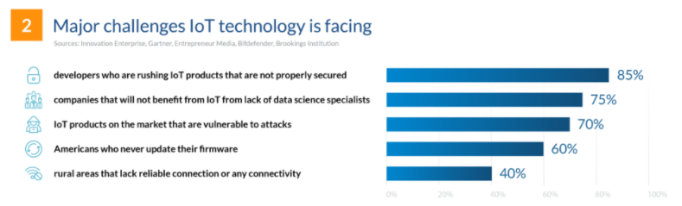
Industry Trends
From https://financesonline.com/iot-trends
Options for mitigating those challenges?

Slide 11
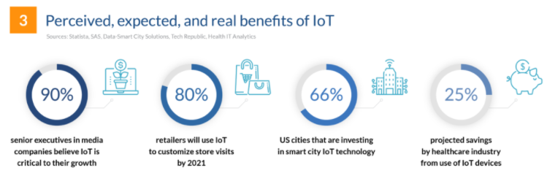
Industry Trends
From https://financesonline.com/iot-trends
How do we help customers realize those benefits?

Slide 12
Industry Trends
Areas of focus:
Accommodating orders of magnitude of growth
Preventing known (or unknown) challenges from impeding success
As a business, effectively leveraging opportunities to meet customer needs
Device Management
Leveraging the Edge
Data Management

Slide 13
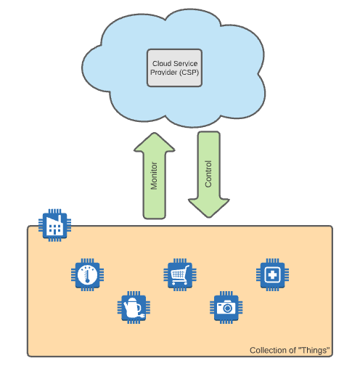
Cloud-Centric IoT (CIoT)
Potential issues with this type of architecture?
Notes:
Think in terms of a connected vehicle or a healthcare device monitoring patient status

Slide 14
Cloud-Centric IoT (CIoT) – Potential Issues
Bandwidth
Latency
Need for “Always On”
Resource Constraints
Security
Data size
Data frequency
Impact of processing delays
Inability to react in “real-time”
Long transmission distances
Intermittent network connectivity
Not enough on-device power for processing complexity
End-to-end transmission consumes precious energy
Sometimes remote and outside
Insufficient on-device capability to prevent service interruption or data “spoofing”

Slide 15
Fog & Edge Computing
At its simplest, involves the injection of intermediate components:
Bring more power closer to the “things”
Offload processing
Optimize what gets transmitted
Caching to remediate intermittent connectivity issues
Supplement with additional layers of security

Slide 16
Fog & Edge Computing
Can include three distinct layers:
Inner or near edge
Middle edge
Outer or far edge

Slide 17
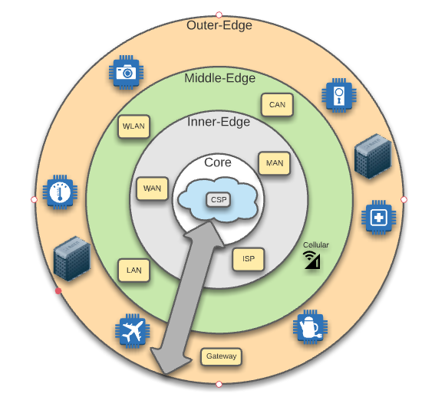
Fog & Edge Computing – Layers
CSP – Cloud Service Provider
WAN – Wide Area Network
ISP – Internet Service Provider
MAN – Metropolitan Area Network
LAN – Local Area Network
WLAN – Wireless Local Area Network
CAN – Campus Area Network

Slide 18
Fog & Edge Computing – Advantages
Security
Cognition
Agility
Latency
Efficiency

Slide 19
Fog & Edge Computing – S.C.A.L.E.
Security:
Additional layers of protection
Can support security patches to devices in remote areas
Improves speed with which patches can be applied
Notes:
Instead of connectivity to the internet, remote device only needs connectivity to local edge component
Faster to apply closer to the device

Slide 20
Fog & Edge Computing – S.C.A.L.E.
Cognition:
More processing power closer to the device
Means more sophisticated decision-making (“smart devices”)
Can include components that enable self-healing
Provides options for even simplest of “things”

Slide 21
Fog & Edge Computing – S.C.A.L.E.
Agility:
Provides additional “levers” for configuration and operation
Enables commoditization of intermediate layer capabilities
Supports reuse of open software interfaces and SDK’s
Notes:
Every large-scale IoT deployment does not have to be a “unicorn”

Slide 22
Fog & Edge Computing – S.C.A.L.E.
Latency:
Improves speed of response to and from the “things”
Optimizes communications by localizing aggregation and processing
Data travels faster over shorter routes

Slide 23
Fog & Edge Computing – S.C.A.L.E.
Efficiency:
Caching and batching can improve overall performance
Data analysis can be completed closer to the device
Can generate results faster by execution closer to the data source
Cloud communication still available but data transmitted can be filtered

Slide 24
How Are Advantages Realized?
Storage
Compute
Acceleration
Networking
Control
Data caching & temporary storage
Data stability & consistency even with network “blips”
Hardware & software for localized execution of logic
Multiple hosting options (including containerization)
Networking acceleration – network virtualization and software-defined network (SDN)
Computing acceleration – vertical and horizontal scaling
Vertical networking – efficient communication across the edge layers
Horizontal networking – efficient communication within the edge layers
Control over deployment
Control over device behavior & configuration
Control of security
Control over management of disparate protocols

Slide 25
Device Management

Slide 26
Device Management
To be secure, IoT systems must manage all points of data ingress and egress
Unknown devices should remain restricted
Need a repeatable process for onboarding/offboarding devices

Slide 27
Device Management
In addition to onboarding, mechanisms for device maintenance required
Firmware updates, security patches, reboots/resets
Supported by a structured lifecycle

Slide 28
Device Management
In many cases, must accommodate hundreds or thousands of devices
May include devices located miles away or in remote areas
Means manual configuration not always feasible

Slide 29
Device Management
Scale & Automation
Openness & Compatibility
Context Awareness
Service Many Roles
Principles

Slide 30
Scale & Automation
Keep human-to-device ratio cost effective (bulk processing)
Automate as much as possible
Enable secure remote management techniques over distance

Slide 31
Openness & Compatibility
Device ecosystem includes multiple variants
Can include different profiles, platforms, and protocols
Requires strategies that:
Can accommodate the variants
Unify where possible from reporting and support perspectives

Slide 32
Context Awareness
IoT environments need to maintain awareness of critical factors like:
SLAs for maintenance windows
Network and power states
Geo-location information (in some applications)
In some systems, lack of awareness can be damaging or dangerous

Slide 33
Service Many Roles
Operational support requirements must be understood
Reporting & dashboarding are key
Need ways to tailor detail to different types of stakeholders
Notes:
Supervisors vs. business – each may care about different info

Slide 34
Device Lifecycle
Plan
Provision
Configure
Monitor
Retire

Slide 35
Device Planning
Develop strategies for grouping of devices for bulk operations
Understand how device will be utilized
Understand context awareness requirements

Slide 36
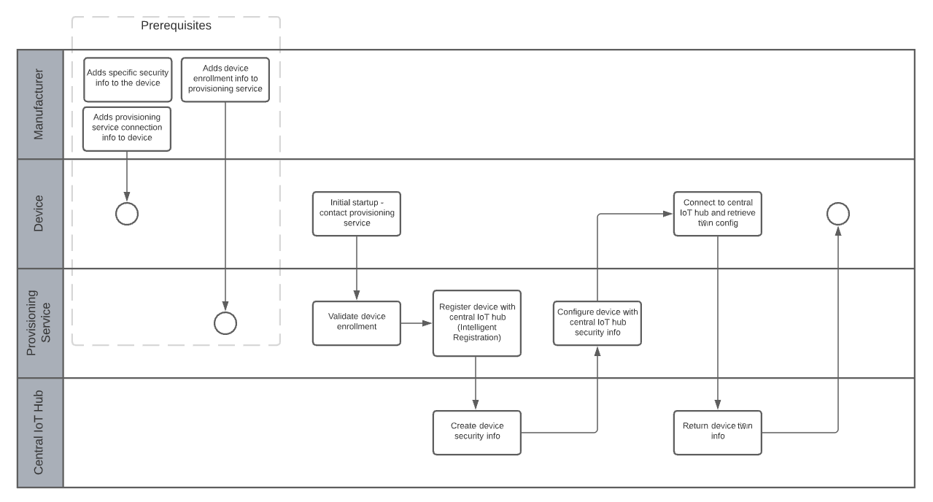
Device Provisioning

Slide 37
Central IoT Hub – Device Registration
Various strategies can be used to assign a device to a hub:
Lowest latency (geographically closest)
Evenly weighted distribution
Static configuration (e.g., assignment based on device grouping)
Custom logic

Slide 38
Device Twins
Provides digital representation of a physical device
Synchronized to the central IoT hub
Enables awareness of device in Cloud without constant interaction

Slide 39
Device Twins
Utilizes “desired” properties to push configuration from Cloud to device
Utilizes “reported” properties to communicate info from device to Cloud
Enables config sync between back-end and device

Slide 40
Device Twins
Examples include:
Use of twin by Cloud to communicate frequency updates to device
Use of twin by device to report on status of requested updates
Use of twin by Cloud to query device state
Use of twin by device to report status of long-running ops (e.g., firmware updates)

Slide 41
Device Configuration
Enable bulk configuration updates, including firmware upgrades
Maintain health of device and data
Execute securely – configuration validation

Slide 42
Device Monitoring
Monitor:
Device health
Status of in-process operations (e.g., firmware upgrades)
Alerts for issues to be reported and remediated
Reporting/dashboarding

Slide 43
Device Retirement
Replacement for failed devices
Device upgrades at end of service lifetime
Can leverage device twin for transferring config to replacement
Alternatively, can archive twin if not being replaced

Slide 44
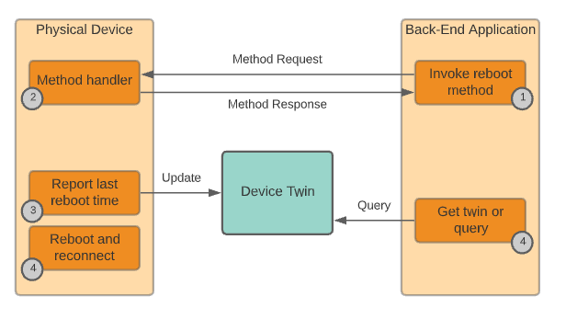
Device Management Patterns
Reboot

Slide 45
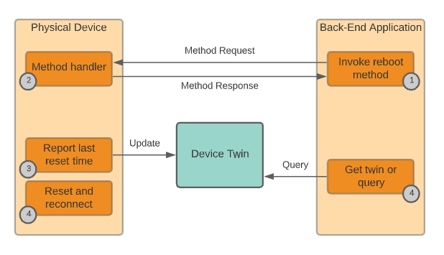
Device Management Patterns
Factory Reset

Slide 46
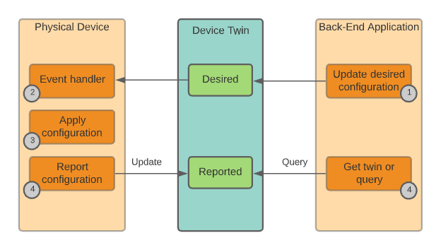
Device Management Patterns
Configuration

Slide 47
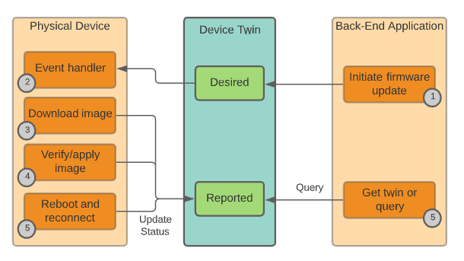
Device Management Patterns
Firmware Update

Slide 48
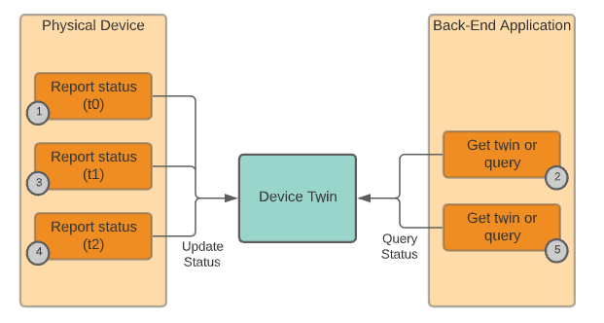
Device Management Patterns
Progress & Status

Slide 49
Case Study
Your team has been hired to design and implement an autonomous vehicle powered by Edge & IoT. High-level requirements are as follows:
Standard routes must be supported – point A to point B
Turns, lane changes, regular traffic stops must occur safely
If weather forecast for an area the vehicle is about to enter indicates treacherous driving conditions, the vehicle should automatically adjust in speed, stopping distance, etc.
If the vehicle is approaching an area where there is significant construction, the vehicle should find an alternate, more efficient route but must confirm with the user before switching to it
The user should be allowed to take control of the vehicle at any time
Information about miles, speeds, maneuvers, weather conditions, and road conditions should be aggregated to a central location for analysis and Machine Learning to foster continuous improvement in safety and utility
What major software/hardware components would you consider including?
What would be the “devices” in this scenario?
What would device registration, configuration, monitoring, and retirement look like in this scenario from an Edge/IoT perspective?

Slide 50
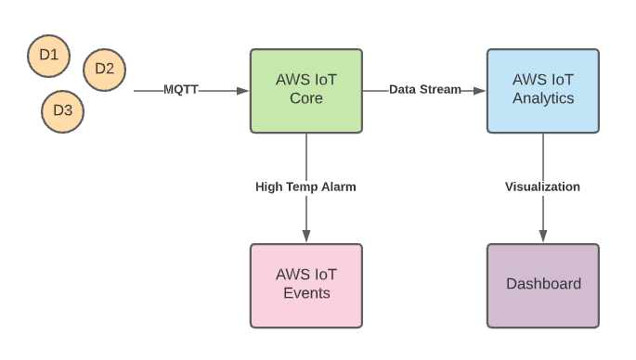
Demo

Slide 51
THANK YOU

